Slide 1

FAQ Chatbot Using Retrieval-Augmented Generation (RAG)
Revolutionizing E-Commerce Customer Support
Presented By
Sai Jitendra Chowdary Katragadda
Deshik Sastry Yarlagadda

Slide 2
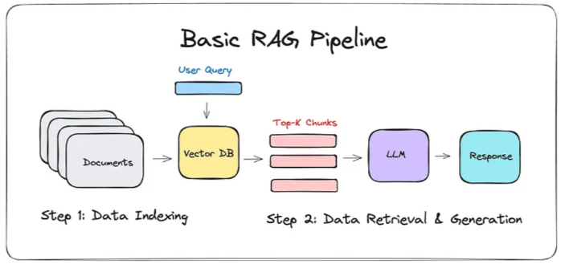
Project Overview
Domain: Customer Support Automation
Corpus:
E-commerce FAQs from Hugging Face (NebulaByte/E-Commerce_FAQs)
Local CSV for custom datasets
Goal:
Retrieve relevant FAQs using semantic search
Generate natural, user-friendly responses
Tech Stack:
Embedding: Sentence-BERT for contextual understanding
Retrieval: FAISS for efficient similarity search
Generation: Phi-2, TinyLlama, or Mistral-7B
Interface: Streamlit for interactive web demo

Slide 3
Usage & Features
Usage:
Select dataset: Hugging Face or local CSV
Choose language: English, Spanish, French
Select LLM:
Phi-2: Balanced for 16GB RAM, CPU/low-end GPU
TinyLlama: Fastest, ideal for low-memory systems
Mistral-7B: High-quality responses, requires 15GB+ GPU
Input question or use sample queries
View retrieved FAQs, generated response, and performance metrics
Submit feedback (1-5 rating)
Features:
Multilingual support
Real-time response generation
Interactive UI with feedback loop

Slide 4
Evaluation & Metrics
Retrieval Metrics:
Run: python -c "from src.utils import evaluate_retrieval; print(evaluate_retrieval(embedder, 'data/test_set.json'))"
Measures precision, recall
Response Metrics:
BLEU, ROUGE scores via faq_data.csv ground truth
Human Feedback:
Ratings stored in feedback.json
Baseline:
RAG vs. keyword search in Streamlit sidebar

Slide 5
Performance & Optimization
Hardware:
CPU (16GB RAM): TinyLlama/Phi-2, 4GB swap
GPU (15GB+ VRAM): Mistral-7B, 4-bit quantization
Auto-detects hardware
Optimizations:
Preload embeddings: embedder.load("embeddings")
Cache queries
Smaller batch sizes
Model warmup

Slide 6
Future Work
Model Enhancements:
Integrate LLaMA-13B for better responses
Fine-tune Sentence-BERT and LLMs on e-commerce data
Scalability:
Support >10,000 FAQs with hierarchical FAISS
Integrate with Shopify, Zendesk
UX Improvements:
Mobile app, multi-turn dialogues
Multi-modal (image/voice) support

Slide 7
Conclusion & Deliverables
Summary:
Scalable, multilingual RAG chatbot
Ready for e-commerce support
Deliverables:
Code: src/, app.py, requirements.txt
Demo: http://localhost:8501
Docs: README.md, inline comments
Metrics: utils.py, feedback.json
Next Steps:
Pilot with e-commerce platforms
Expand dataset and integrations

Slide 8
Thank you

